Slide 1
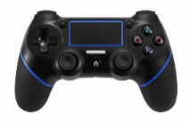
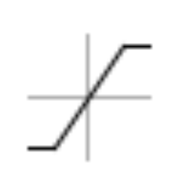
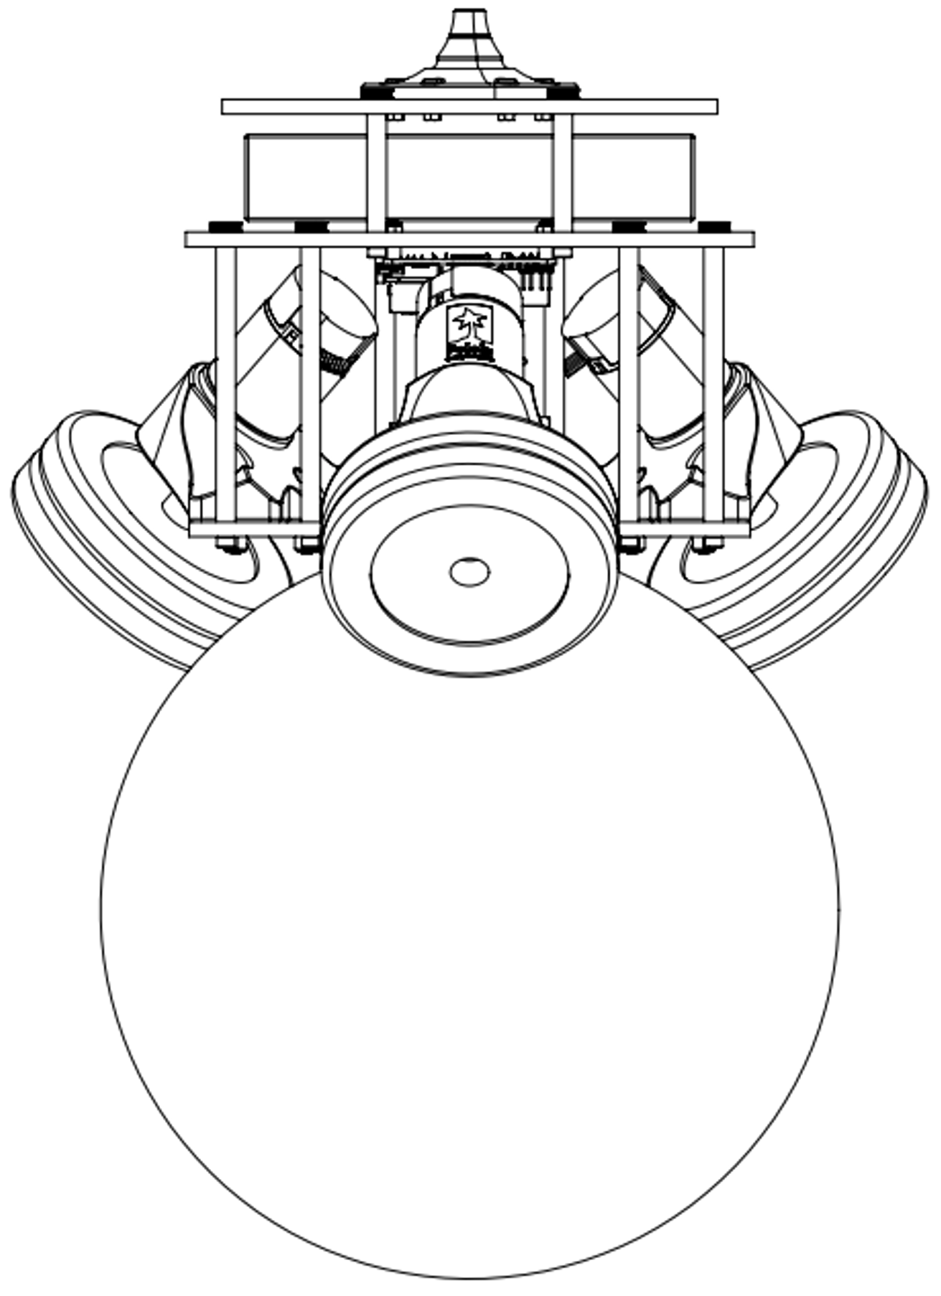
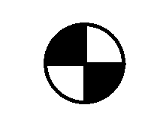
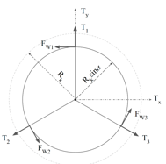
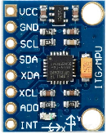



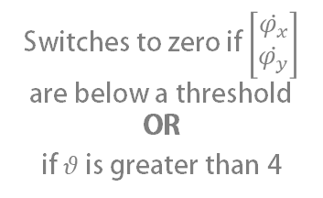









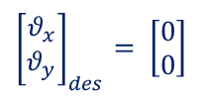









Creating your Block Diagram
Use the schematic below to modify and create the block diagram that describes your controller
Deadband
$$\left[\begin{matrix}e_{\dot{φ}x} \\ e_{\dot{φ}y}\end{matrix}\right]$$
$$\left[\begin{matrix}\dot{φ_{x}} \\ \dot{φ_{y}}\end{matrix}\right]$$
Switches to zero if $\left[\begin{matrix}\dot{φ_{x}} \\ \dot{φ_{y}}\end{matrix}\right]$ are below a threshold OR
if $θ$ is greater than 4
$$0$$
$$PID$$
$$\frac{d}{dt}$$
$$+$$
$$−$$
$${\left[\begin{matrix}T_{x} \\ T_{y}\end{matrix}\right]}_{steering}$$
Physical system (plant)
$$0.4$$
Motor torques
$$\left[\begin{matrix}e_{θx} \\ e_{θy}\end{matrix}\right]$$
-$0.4$
Torque conversion
X-Z plane
Saturation
$$\left[\begin{matrix}T_{1} \\ \begin{matrix}T_{2} \\ T_{3}\end{matrix}\end{matrix}\right]$$
Y-Z plane
$$\left[\begin{matrix}T_{x} \\ T_{y}\end{matrix}\right]$$
$$+$$
$$PID$$
$$0.6$$
$$+$$
-$0.6$
$$+$$
$$−$$
Meas. $\left[\begin{matrix}φ_{x} \\ φ_{y}\end{matrix}\right]$
$${\left[\begin{matrix}T_{x} \\ T_{y}\end{matrix}\right]}_{balance}$$
$${\left[\begin{matrix}θ_{x} \\ θ_{y}\end{matrix}\right]}_{des}= \left[\begin{matrix}0 \\ 0\end{matrix}\right]$$
Measured $\left[\begin{matrix}θ_{x} \\ θ_{y}\end{matrix}\right]$
Actual $\left[\begin{matrix}θ_{x} \\ θ_{y}\end{matrix}\right]$
ROB 311

